Slide 3

Selling management system for restaurant
GRADUATION THESIS
Student: Tran Duc Viet
Supervisors: MsC Nguyen Duy Hiep
Notes:
Distinguished Chairperson, esteemed members of the council, and honored guests,
Allow me to introduce myself. My name is Tran Duc Viet. Today, I am deeply honored to present and defend my graduation thesis before this committee. My thesis topic is "Selling Management System for Restaurant," which I have conducted under the dedicated guidance of my supervisor, M.Sc. Nguyen Duy Hiep.

Slide 4
TABLE OF CONTENTS
Problem & Motivations
Survey
System design
Solution & Contribution
Conclusion & Future work

Slide 5
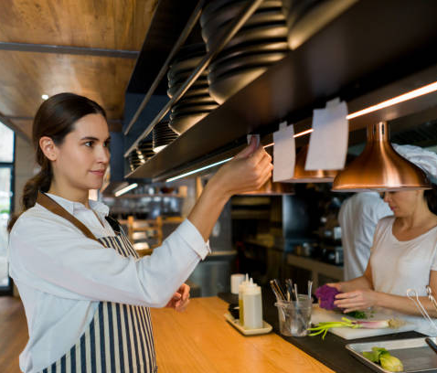

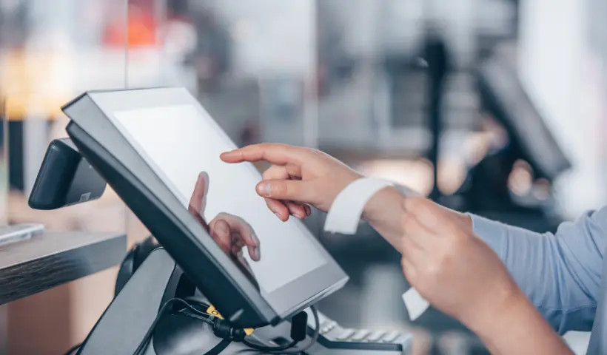
Problem & Motivation
Notes:
Despite rapid advancements in technology, many dining establishments still struggle with managing orders, placing orders, and settling payments.

Slide 6

Problem & Motivation
Complexities
Inaccuracies
Negative impact on service quality and reputation
Notes:
These challenges cause complexities, inaccuracies, and negatively impact on service quality and reputation.

Slide 7




Problem & Motivation
For Big Restaurants
High operating and maintenance costs of these systems
Requiring investment in specialized equipment
Notes:
In Vietnam, the demand for restaurant management solutions is rising.
There are some existing systems in viet nam like CukCuk, PosApp, SapoFnb, and iPos.
However, those systems are mainly for big restaurant or restaurant with multiple branches because of the high operating and maintenance costs of these systems and the requiring investment in specialized equipment that small and medium-sized restaurant in viet nam cannot afford.

Slide 8
Problem & Motivation
Small and medium-sized restaurants can easily apply.
Improving ordering and service processes.
Minimizing investment and operating costs.
Providing a seamless payment function for restaurants
Notes:
This thesis aims to create a system that small and medium-sized restaurants can easily apply to improve their ordering and service processes while minimizing investment and operating costs, and providing a seamless payment function for restaurants

Slide 9
Survey
Criteria | PosApp | SapoFnb
Interface | - Modern and user-friendly. - Multi-platform(web, mobile). | - Intuitive and easy to use. - Supports multiple devices.
Features | - Order and delivery management. - Branch management. - Integrated online payments. | - Order and delivery management. - Inventory management and revenue reporting. - Staff and customer management.
Customization | - Flexible customization. - Easy integration with other software. | - Moderate customization. - Integration with Sapo ecosystem.
Cost | - Reasonable cost. - Various service packages suitable for different restaurant sizes. | - Moderate cost. - Service packages suitable types of businesses.
Customer Support | - Professional support via chat, phone, and email. | Dedicated and professional support through online and on-site support.
Scalability | - Good for restaurants with multiple branches. | - Good scalability within the Sapo ecosystem
Disadvantages | - Interface may be challenging for non-tech-savvy-users. - High maintenance costs. | - Moderate cost but still high for small restaurants. - Features may not suit small-scale restaurants
Notes:
I have made a table of comparison of two famous system in viet nam which are PosApp and SapoFnb by some criteria.
Interface:
Both systems offer modern, user-friendly interfaces. PosApp emphasizes its multi-platform capability (web, mobile), while SapoFnb focuses on intuitiveness and ease of use. Both support multiple devices, making them versatile for different restaurant setups.
Features:
Both systems provide order and delivery management. PosApp offers branch management and integrated online payments, which are crucial for multi-location restaurants. SapoFnb, on the other hand, focuses more on inventory management, revenue reporting, and staff/customer management.
Customization:
PosApp appears to offer more flexible customization options and easier integration with other software. SapoFnb provides moderate customization but is specifically designed to integrate well within the Sapo ecosystem.
Cost:
Both systems are described as having reasonable or moderate costs. PosApp offers various service packages suitable for different restaurant sizes, while SapoFnb's packages are tailored to different business types.
Customer Support:
PosApp provides professional support via multiple channels (chat, phone, email). SapoFnb offers dedicated and professional support both online and on-site.
Scalability:
PosApp is noted as being good for restaurants with multiple branches, suggesting strong scalability. SapoFnb offers good scalability within the Sapo ecosystem.
Disadvantages:
PosApp's interface may be challenging for non-tech-savvy users and has high maintenance costs. SapoFnb's moderate cost might still be high for small restaurants, and its features may not be suitable for small-scale operations.

Slide 10
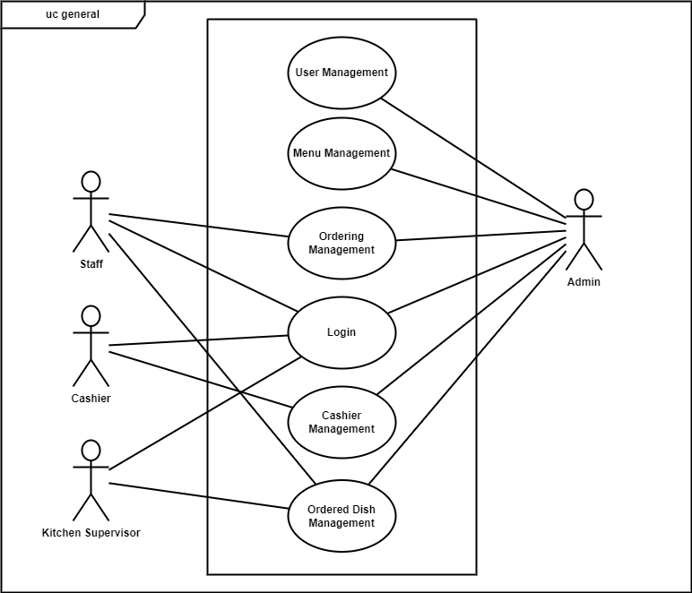
System Design
Main features of the system:
User management
Menu management
Cashier management
Ordering management
Ordered dish management
Notes:
After the survey I have designed my system to have 5 key features:
- User management for managing user using the system.
- Menu management for managing dishes in the menu.
- Cashier management for payment and see the list of paid order information to planning future work for restaurant.
- Ordering management for placing order of customers from table.
- Ordered dish management for managing the cooking dish process in the kitchen.

Slide 11
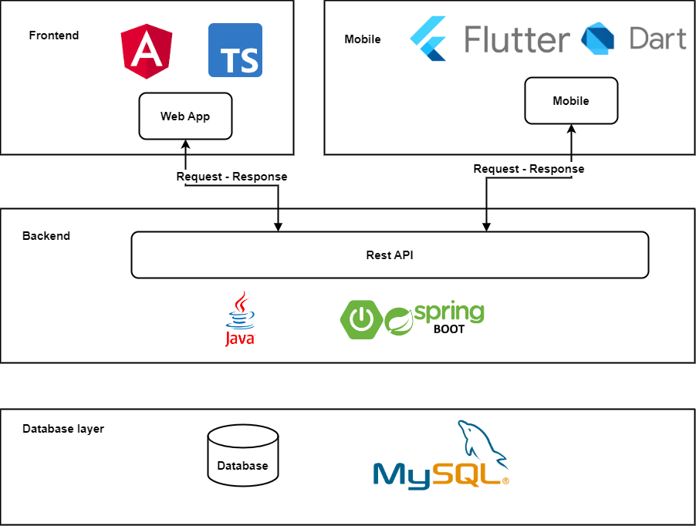
System Design
Frontend for user management, menu management, ordered dish management, cashier management
Mobile for ordering managment
Notes:
Showing the design of selling management system for restaurant.
The System uses client- server architecture and include a web app made with Angular framework and typescript, a mobile application made with flutter framwork and dart. Moreover, Backend uses Springboot framework and java with MySql for database.
The Frontend is built for user management, menu management, ordered dish management, cashier management features.
The mobile is for Ordering management features.

Slide 12
Solution & Contribution
Reduced development and operational costs.
Easier maintenance and future upgrades.
Cost-effective for small and medium-sized restaurants with limited IT budgets.
Notes:
As I mentioned before I will create a system that helps developers and restaurant minimizing investment and operating costs. So, I decided to use opensource tech stack to build this system, which helps to reduce the development and operational costs, easy to maintenance and future upgrades. Moreover, it is also very cost-effective for small and medium-sized restaurants with limited IT budgets.

Slide 13
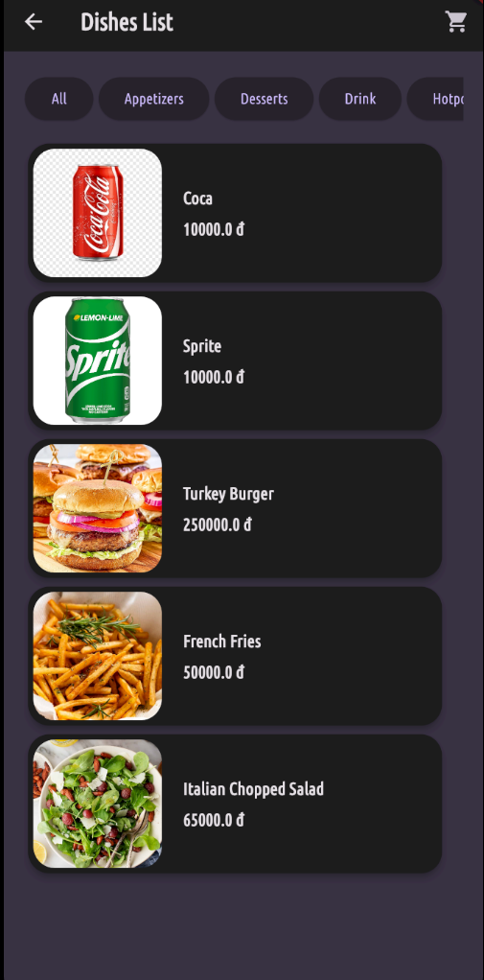
Solution & Contribution
Development of a multifunctional web app to optimize restaurant ordering and service processes while keeping cost low
Core component: Mobile application designed for waitstaff to quickly and accurately record orders at the customer's table
Detailed electronic menu with images, descriptions, and pricing information
Utilizes staff's personal mobile devices to save on equipment costs and increase flexibility
Notes:
To create a system that small and medium-sized restaurants can easily apply to improve their ordering and service processes while minimizing investment and operating costs, I have come up with the solution which is Development of a multifunctional web app to optimize restaurant ordering and service processes while keeping cost low with:
Core component: Mobile application designed for waitstaff to quickly and accurately record orders at the customer's table
Detailed electronic menu with images, descriptions, and pricing information
Utilizes staff's personal mobile devices to save on equipment costs and increase flexibility.

Slide 14
Solution & Contribution
Waitstaff:
Quickly and accurately record orders right at the customer’s table through a detailed electronic menu on the mobile app.
=> Improving work efficiency, increasing flexibility in the service process, saving on equipment investment costs by utilizing staff’s personal mobile devices.
Notes:
Through this Solution, Waitstaff can:
Quickly and accurately record orders right at the customer’s table through a detailed electronic menu on the mobile app.
=> improving work efficiency, increasing flexibility in the service process, saving on equipment investment costs by utilizing staff’s personal mobile devices.

Slide 15
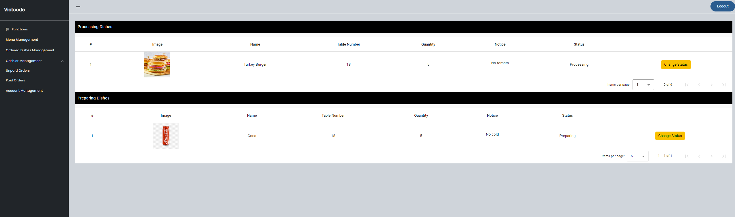
Solution & Contribution
Improving of kitchen process
Managing orders more effectively
Notes:
Through this Solution, it will improve kitchen process , manage orders more effectively through the Ordered dish management featured of the system.
The kitchen process has been significantly improved with a system that auto-mantically transfers order information in real-time. The kitchen staff can manage orders and dishes status more effectively through an intuitive interface, helping to minimize waiting times and errors. The feature ensures that food is served promptly, maintaining optimal quality, temperature, and enhancing the customer experience.

Slide 16




Solution & Contribution
QR Payment System (QRPay): Convenient for customers, minimizes cash handling risks, and increases transaction speed.
Notes:
Moreover, to provide a seamless payment function for restaurants, the integration of the QR payment system (QRPay) is a great choice, which has brought convenience to customers while helping restaurants minimize risks and increase transaction speed.
To make this, I use VietQR Technology to generate QR code. I decided to use VietQR because:
• Flexibility and ease of deployment
• Clear documentation for QR code generation
• Customizable payment information
To confirm transactions, I use Casso's Service which connects with various banks without complex processes, real-time tracking of transactions, and enhances financial management efficiency and transparency to exports transaction info to Google Sheets. Then I use Google Apps Script extension to create a server to retrieve recent transactions for quick processing. After that, at the backend, the system will compares order amount with transaction amount got from the server and confirms successful transactions or handles errors.

Slide 17
Conclusion & Future work
- System Overview:
Developed a restaurant sales management system with key functions: User Management, Menu Management, Order Management, Cashier Management, Ordered Dish Management.
Optimizes ordering and service process at a low cost, suitable for small and medium-sized restaurants in Vietnam.
- Achievements:
Enhanced programming skills in Flutter, Dart, Angular, and Typescript.
Gained valuable project management and software development experience

Slide 18
Conclusion & Future work
Limitations:
Interfaces need further polish and aesthetic improvements
Lacks real-time data update features
JWT is created upon login but not yet authorized at the backend, leaving APIs publicly accessible

Slide 19
Conclusion & Future work
Future work:
Middleware for JWT authentication and secure APIs
Return function
Instant interface updates with data changes.
Responsive interfaces and dedicated mobile apps
Automatic transaction verification with banks
Online ordering system, smart notification systems, AI integration for demand prediction
Provide 24/7 technical support function.

Slide 20
Conclusion & Future work
Ability to Transition to a Service Rental Model:
Affordable
Flexible and easily expandable software
Easy integration
24/7 technical support
Notes:
Moreover, this system can easily be adaptable to change to a service rental model.
Flexible and easily expandable software: Can integrate new features flexibly.
Affordable: Flexible payment models, suitable for small store budgets.
24/7 technical support: Ensures timely resolution of issues.
Easy integration
The system can easily transition to a service rental model, enabling small stores to access modern management technology at a reasonable cost.

Slide 21
THANK YOU !

Slide 22
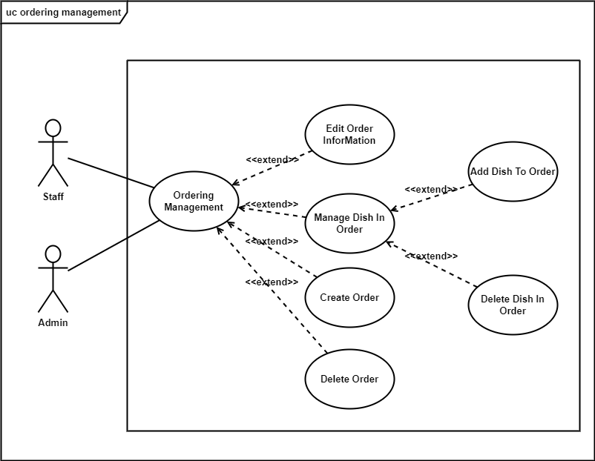
Usecase ordering management phân rã lv2

Slide 23
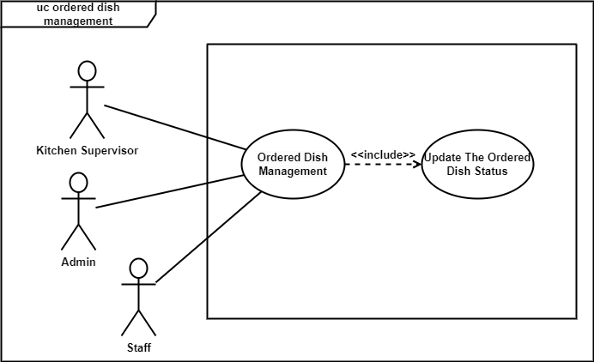
Usecase ordered dish management phân rã lv2

Slide 24
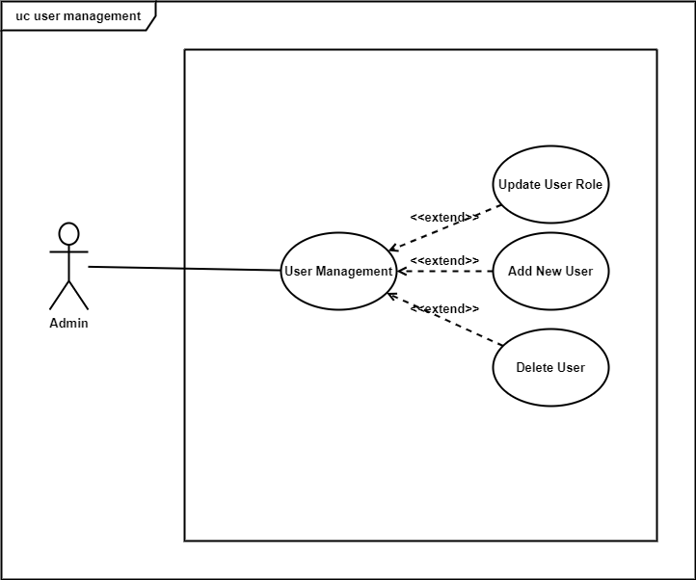
Usecase user management phân rã lv2

Slide 25
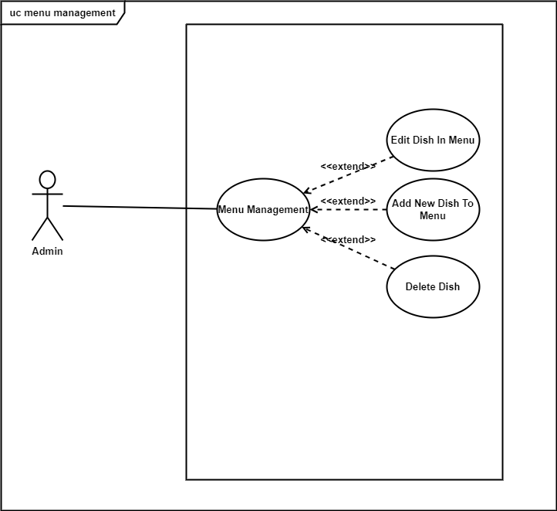
Usecase menu management phân rã lv2

Slide 26
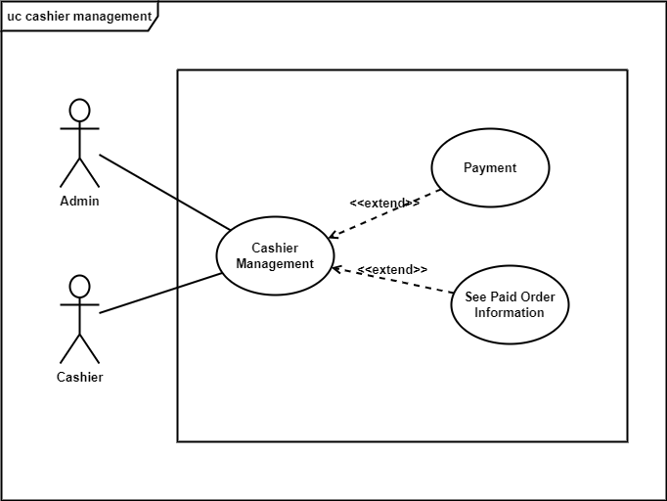
Usecase cashier management phân rã lv2

Slide 27
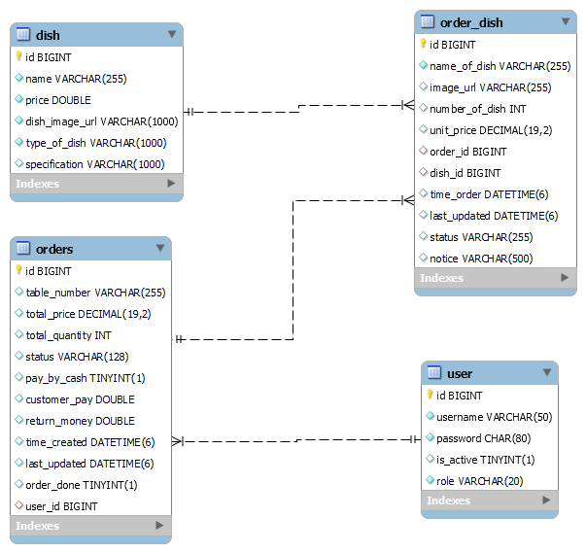
Database

